Slide 1

Use LLMAD to Solve Your Task
(Example on TSP Heuristic Design)
LLM4AD Tutorial Section I
LLM4AD Team
Dec. 2024

Slide 2
1. Formulate the problem
Starting Node
Input: Given a distance matrix.
Objective: Minimizing the route.
Constraint:
  The starting node is randomly selected.
  Traverse all cities only once.
  Back to the starting node.

Slide 3
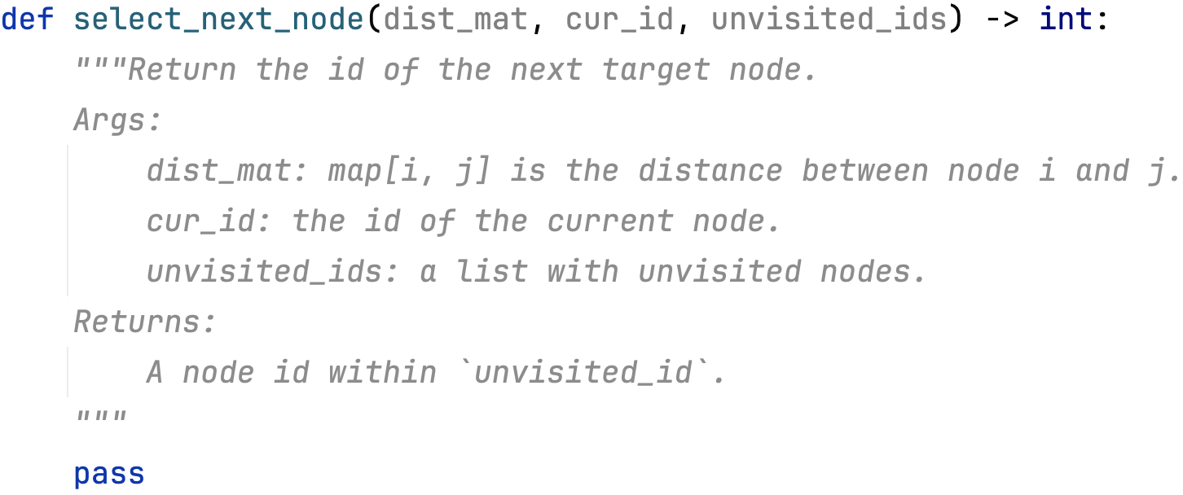
2. Understand the algorithm design task
💡Design a constructive heuristic
We are here
We input the distance matrix, current node, and unvisited nodes.
We expect the next node to go.
Go to the nearest
Go to the farthest

Slide 4
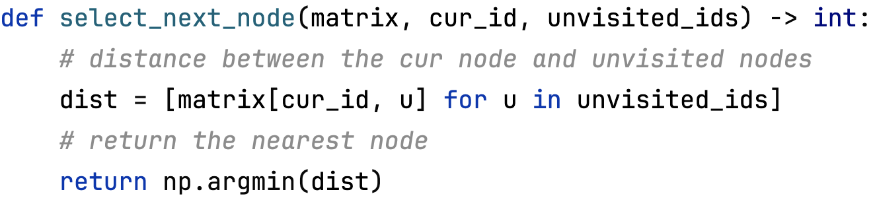
3. Measure the performance score
💡Algorithm: select the nearest node
📝Evaluate the algorithm
Score: 42
Total distance: 42

Slide 5




Thank you!
GitHub Link
Docs Link
Website Link
Paper Link

